Slide 1

Python Project Presentation
Project Title:
Presented By
1. Md. Tanvir Ahmed(201-15-13602)
2. Imran Ahmed(201-15-13600)

Slide 2
Outline
Objective
Working Procedure
Project User Interface
Input Out Demo
Expected Outcomes
Conclusion
Python Project Presentation

Slide 3
Objective
This Virtual Hospital Project is developed based on the general needs required by users(patients/doctors) while using the web application for virtual medication and treatment.
This Project will provide necessary treatment for the patients and a well-organized medication and management system for the doctors.
The web application will be very user friendly, and it is expected that doctors and patients will be benefitted highly by using the features of it.
Python Project Presentation

Slide 4
Working Procedure
As we developed a web application, we needed to use a Python Framework which in this case is Flask. We installed Flask and necessary decorators which had been used for developing our web application. We used Sqlite3 database for storing the information of two kind of user(Doctor and Patient). Sqlite3 database connects with Flask-SqlAlchemy which readily extends for larger applications. As our project is on Virtual Hospital we made two login and signup pages for Doctor and for the Patient. After this, we had written codes for the frontend side and then we connect it with the back-end of our web application. We have used template inheritance for reusing the codes and association between Doctor and Patients class.
Python Project Presentation

Slide 5
Working Procedure
A patient can sign up with a valid information’s. After signing in the web application the patient user will be able to make appointment to a certain available doctor. He can take a look at the appointment information, give feedback on the treatment. The case of Doctor user signup and sign in is as similar as the Patient user. When the doctors signs in his account he can see the list of the patients who had taken appointment to him. He can also update their medication, check feedback and remove them after the treatment. Both the users can see their profile page and the available doctors. After completing their goal they can logout from the system.
Python Project Presentation

Slide 6
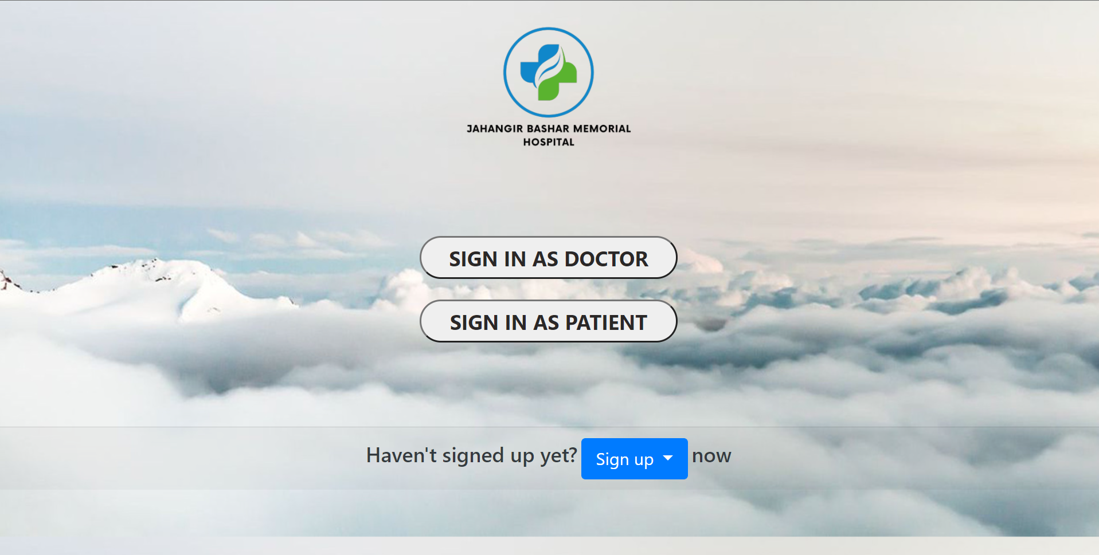
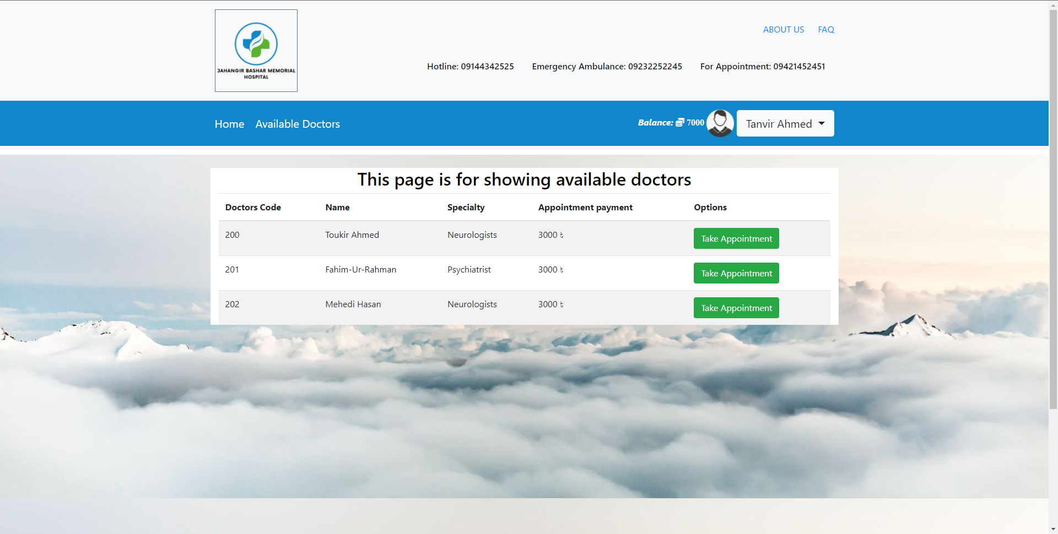
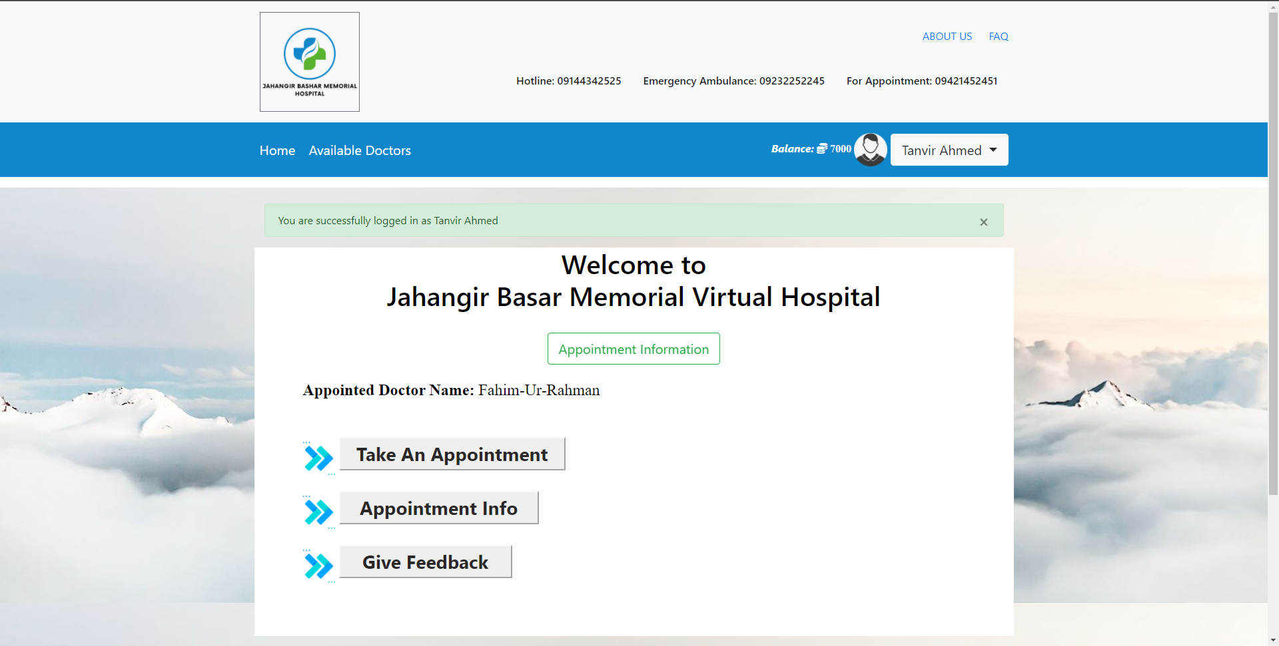
Project User Interface
Python Project Presentation

Slide 7
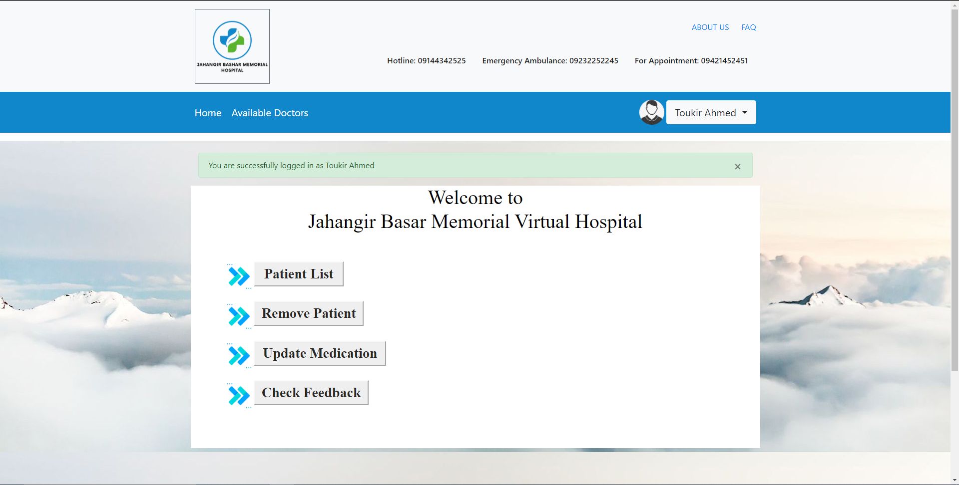
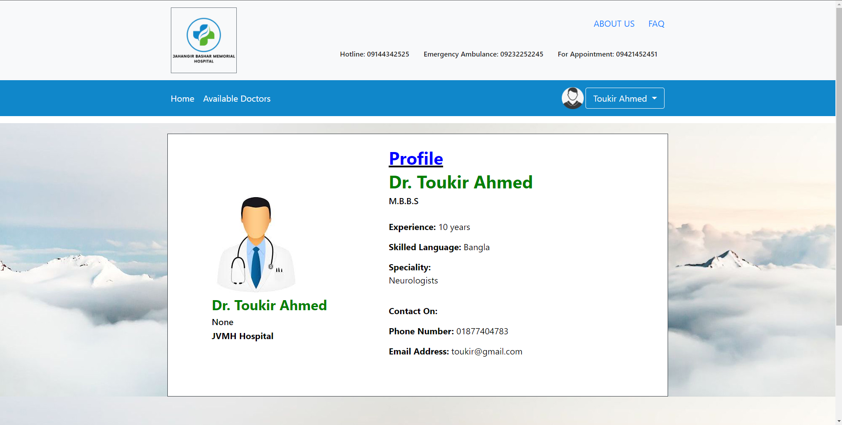
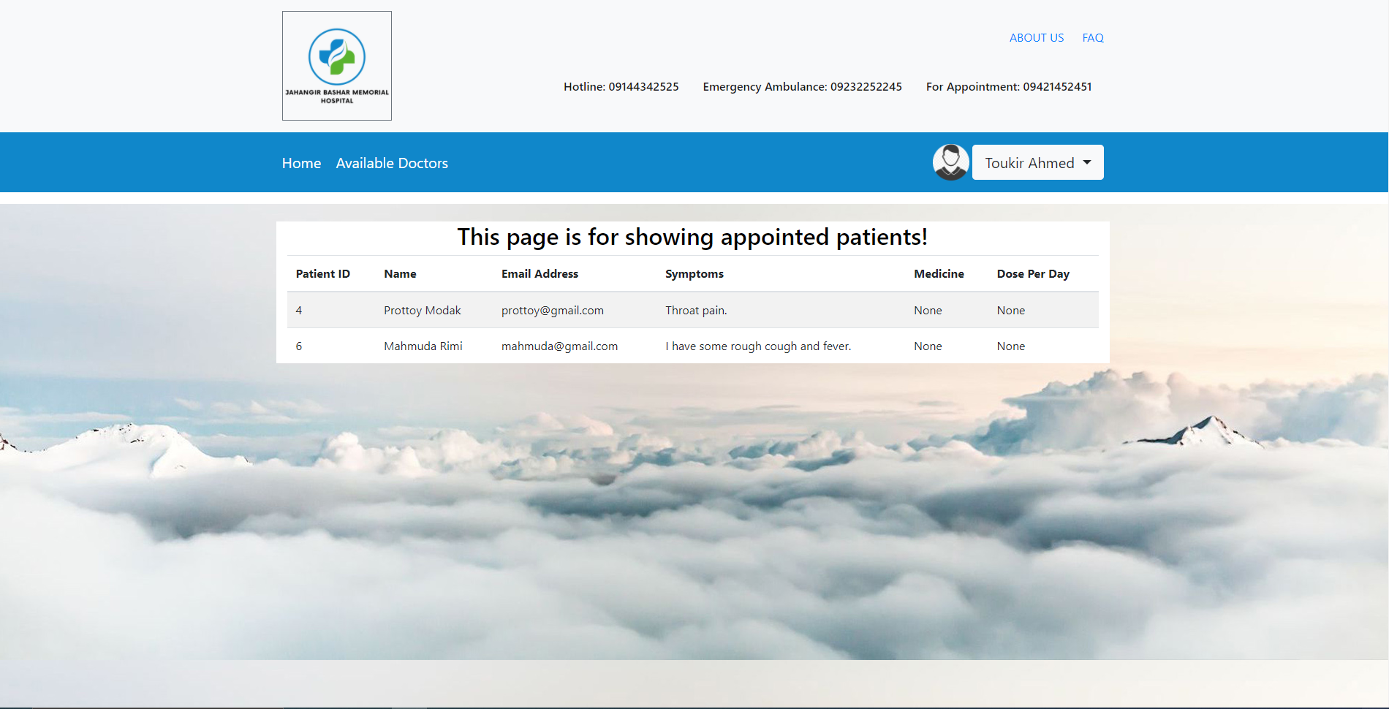
Project User Interface
Python Project Presentation

Slide 8
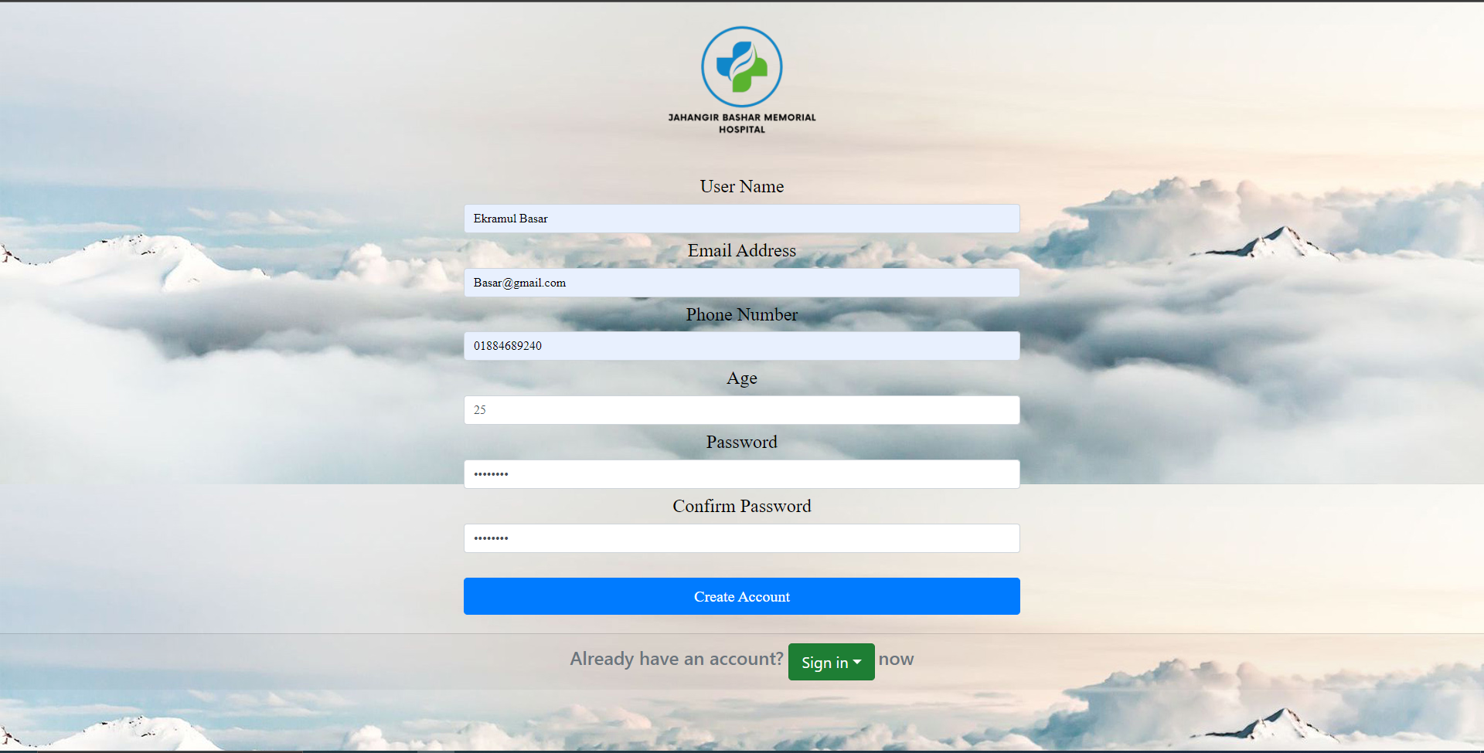
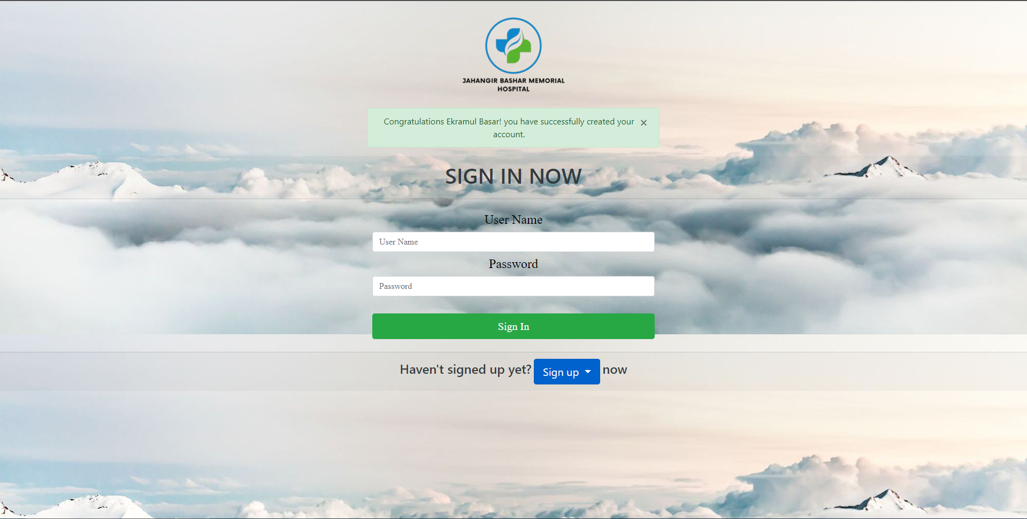
Input Out Demo
Python Project Presentation

Slide 9
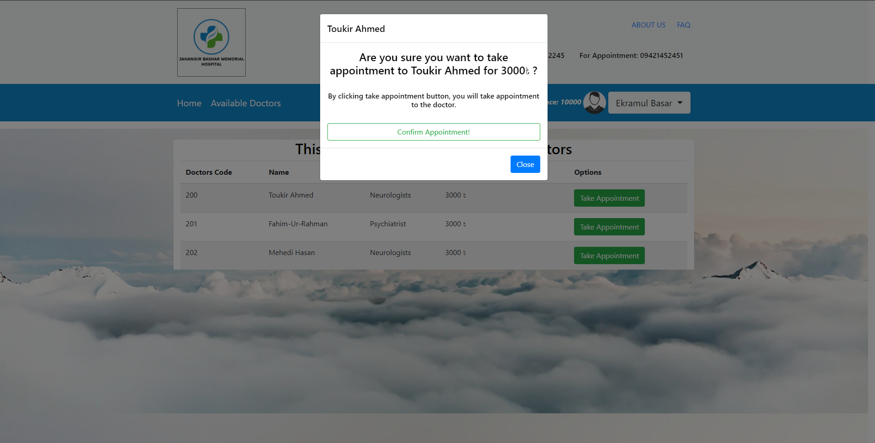
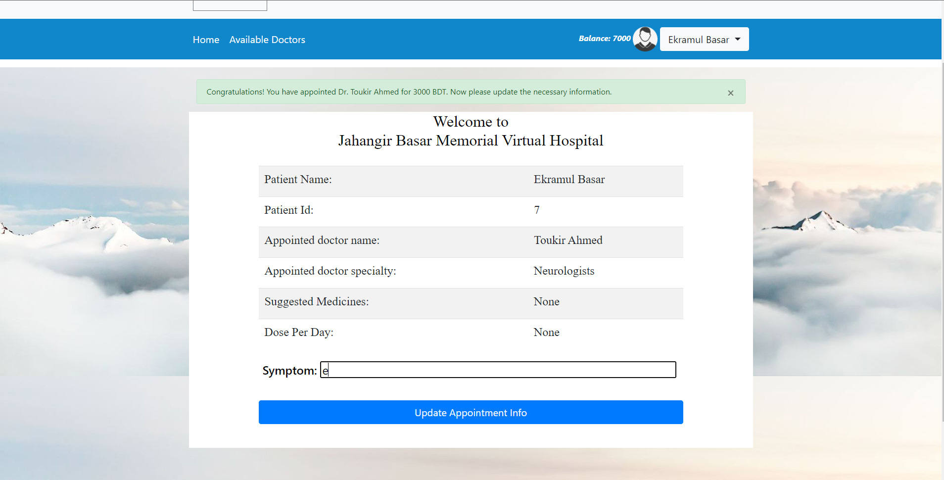
Input Out Demo
Python Project Presentation

Slide 10
Expected Outcomes
Patient as user:
Available_Doctors(): Patients can see all the available doctors for appoinment.
Take_Appoinment(): Patients can take appointment of available Doctors as his/her’s needs.
Give_Feedback(): Patients can give feedback after their medication by preserving their health situation.
Appointment_Info(): Patient can have a look on their appointment
information.
Python Project Presentation

Slide 11
Expected Outcomes
Doctor as user:
Patient_List(): Doctors can see the appointed patients and their given information.
Remove_Patient(): Doctors can remove a particular pateint after his/her treatment has been completed.
Update_Medication(): Doctors can provide or update the medication of a patient according to his/her health situation.
View_Feedback(): Doctors can see the feedback given by the appointed
patients after the treatment.
Python Project Presentation

Slide 12
Conclusion
We have tried our level best to create an accurate web application that would help not only the patients but also their doctors to give better treatment virtually. We faced some issues in handling exceptions in one or two cases. Except those the web application runs almost perfectly. We have also thought to take this project even more further. Adding the feature of pre-determination of a diseases using machine learning technology. Finally, we are very happy to present our project which is gained by hard work.
Python Project Presentation

Slide 13
Thank You
Python Project Presentation

